Slide 1
covid-institutions.humspace.ucla.edu
wireframes
by group a5: chinmaya vempati, christy yee, Daniel Jaffe, Muthu palaniappan, Simon zhang, zack packin

Slide 2
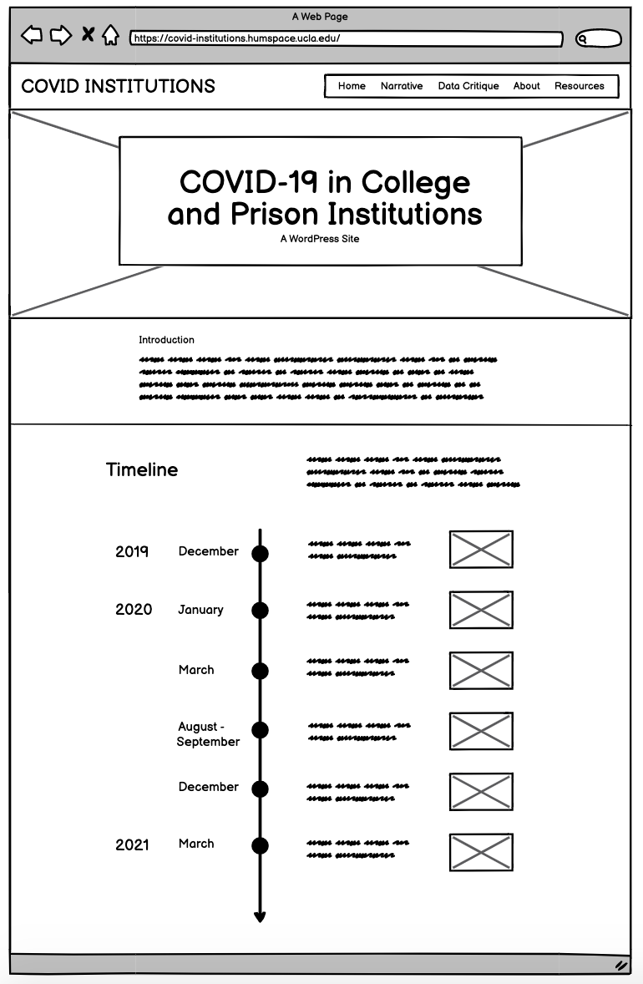
HOME PAGE

Slide 3
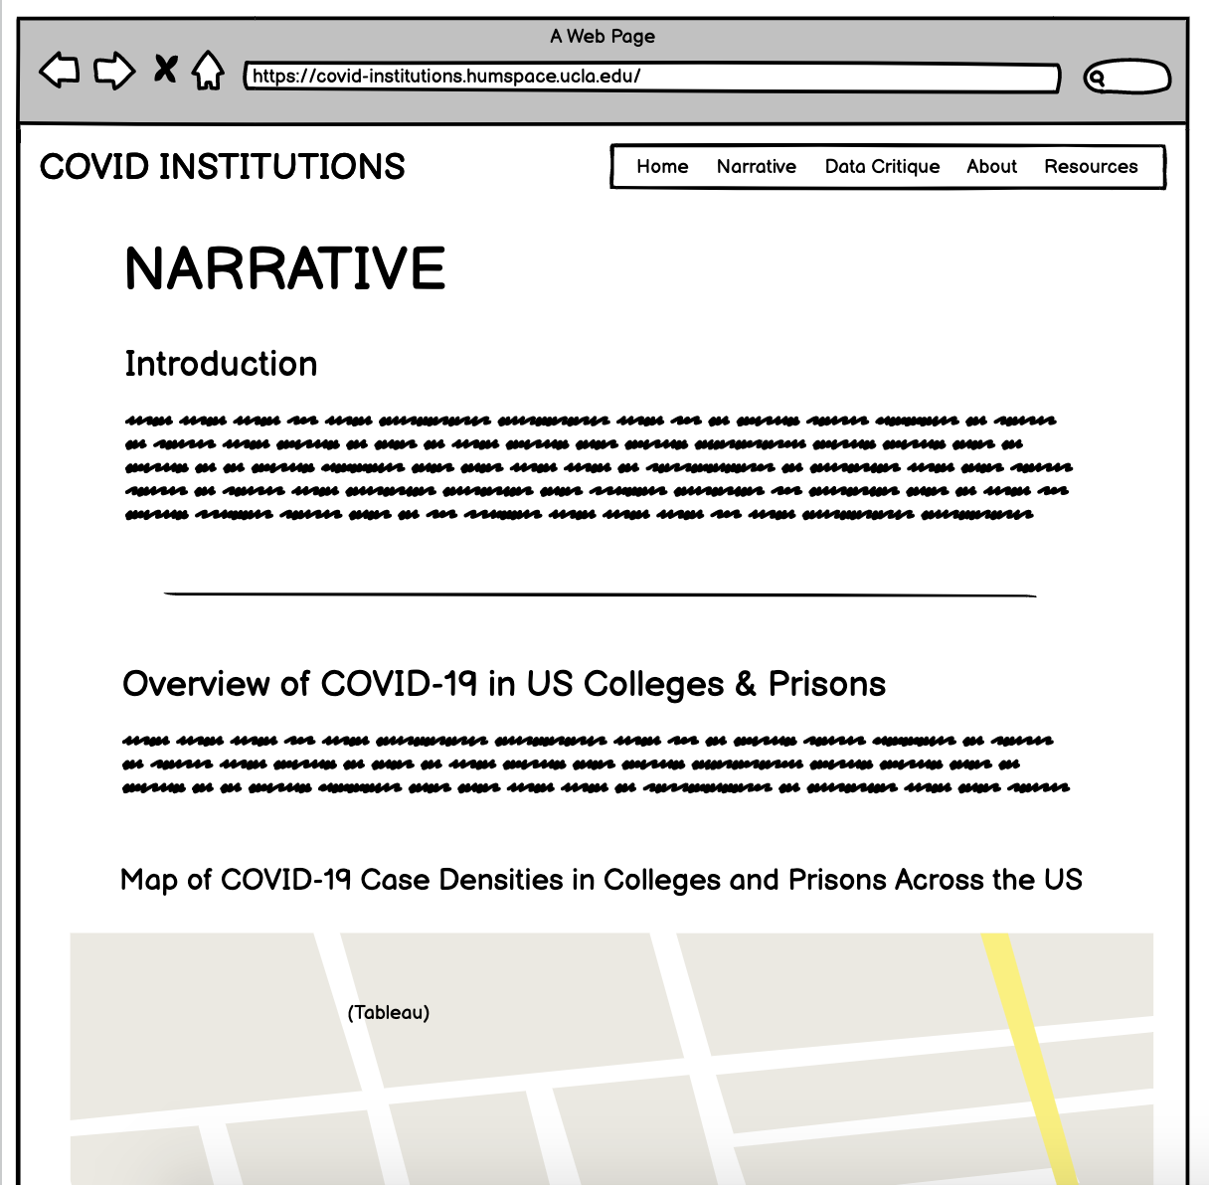
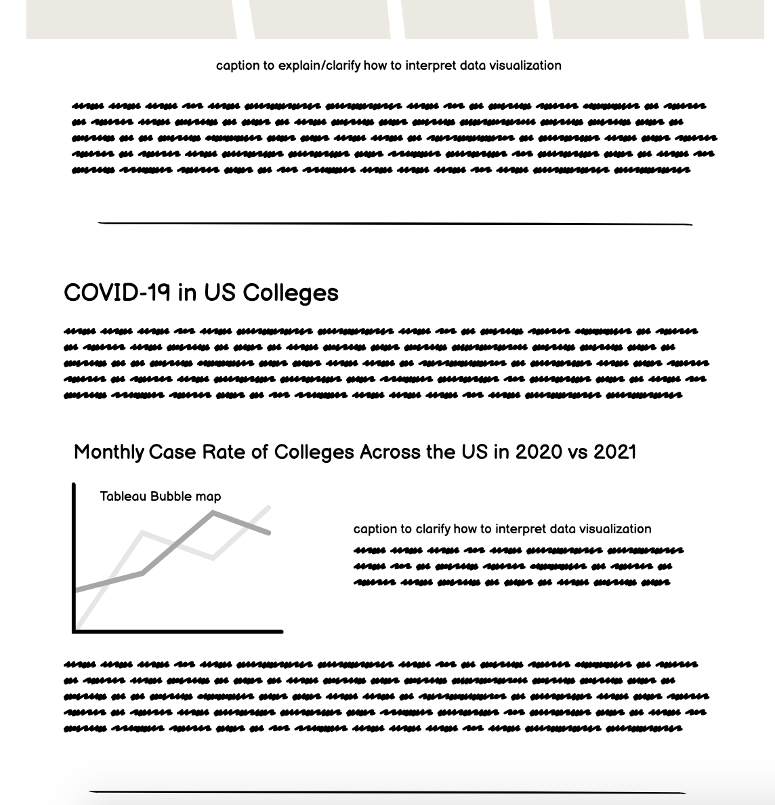
NARRATIVE PAGE (CONTINUED)

Slide 4
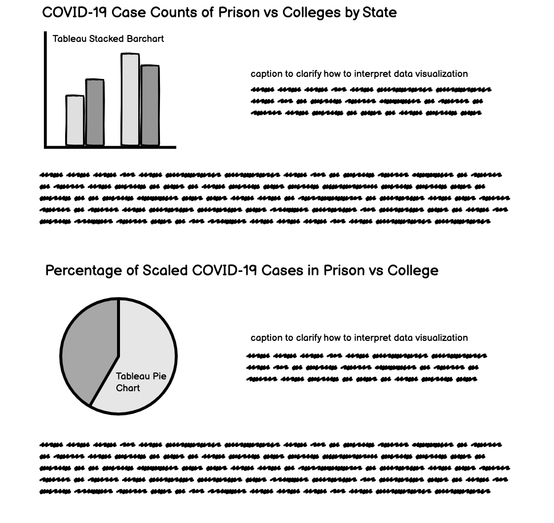
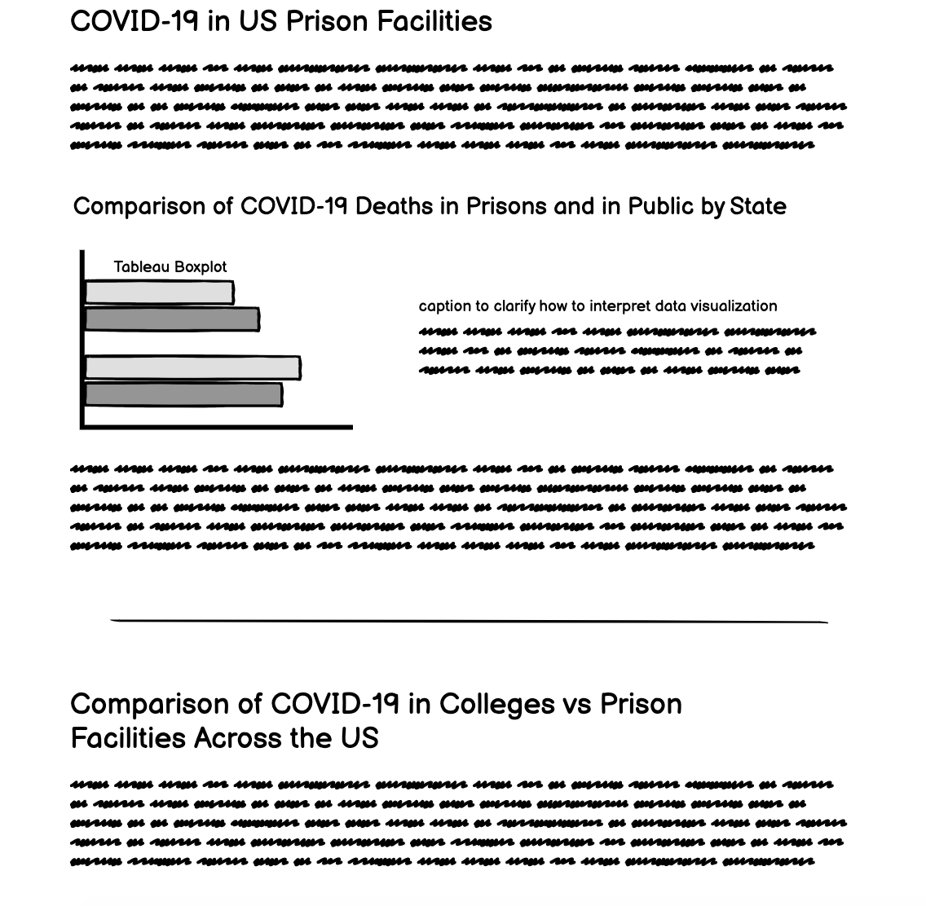
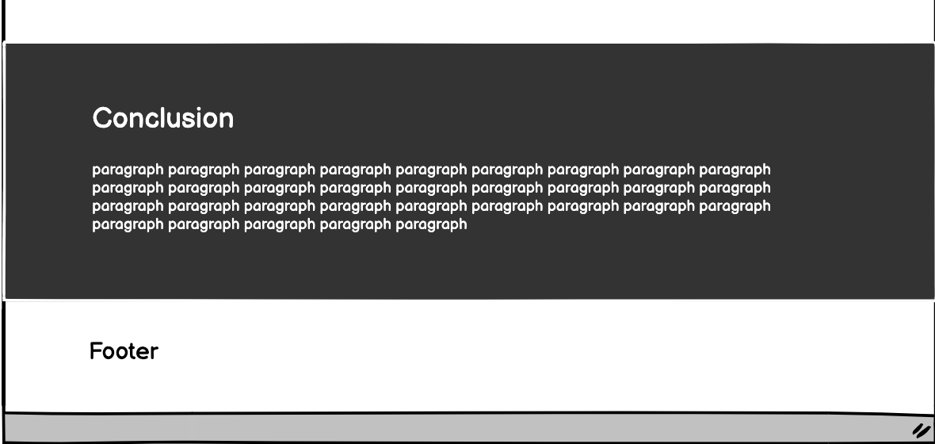
NARRATIVE PAGE (CONTINUED)

Slide 5
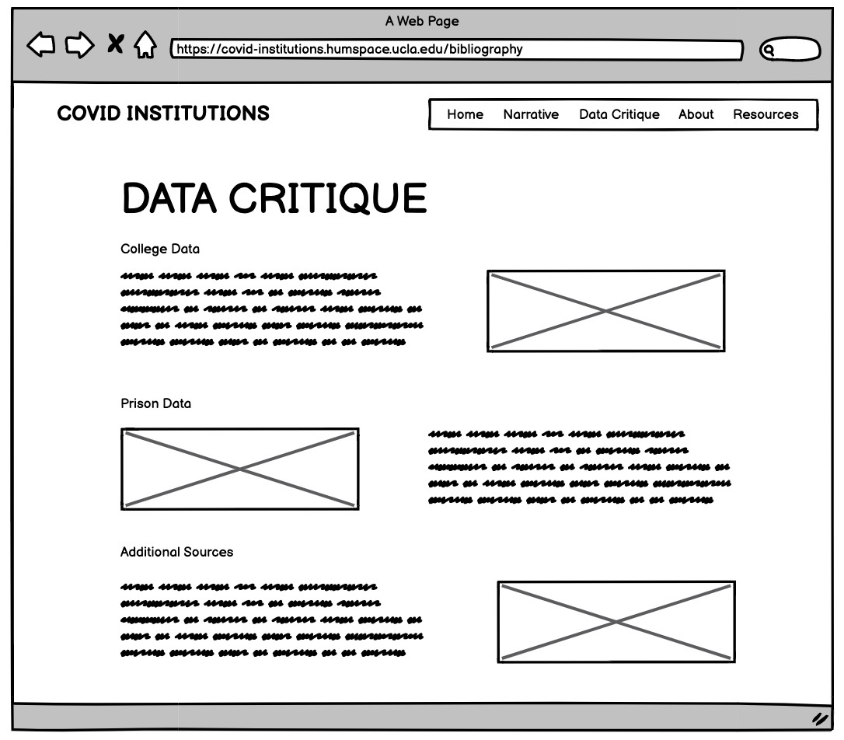
DATA CRITIQUE PAGE

Slide 6
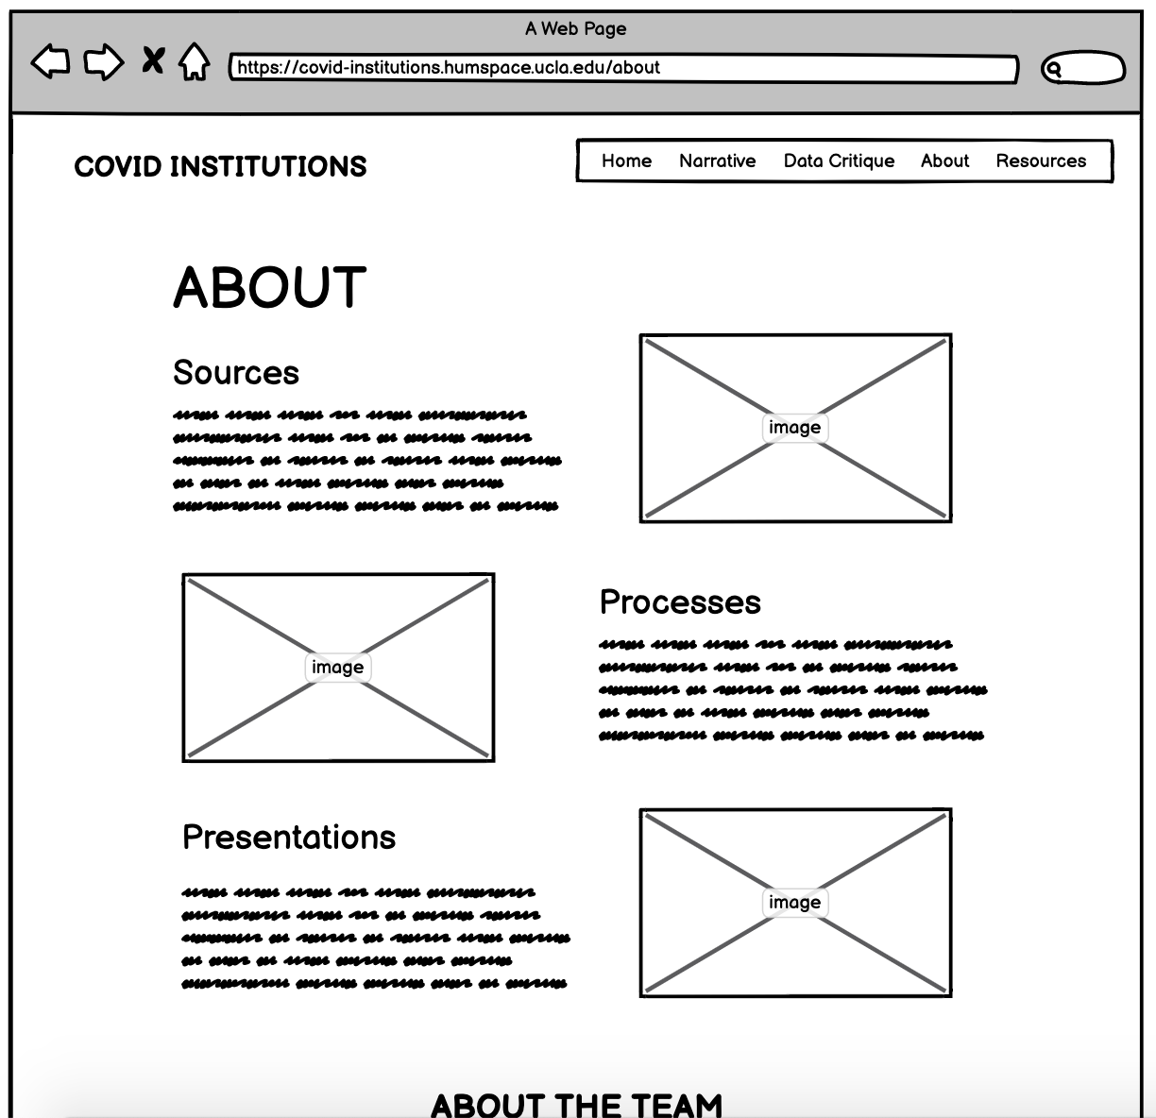
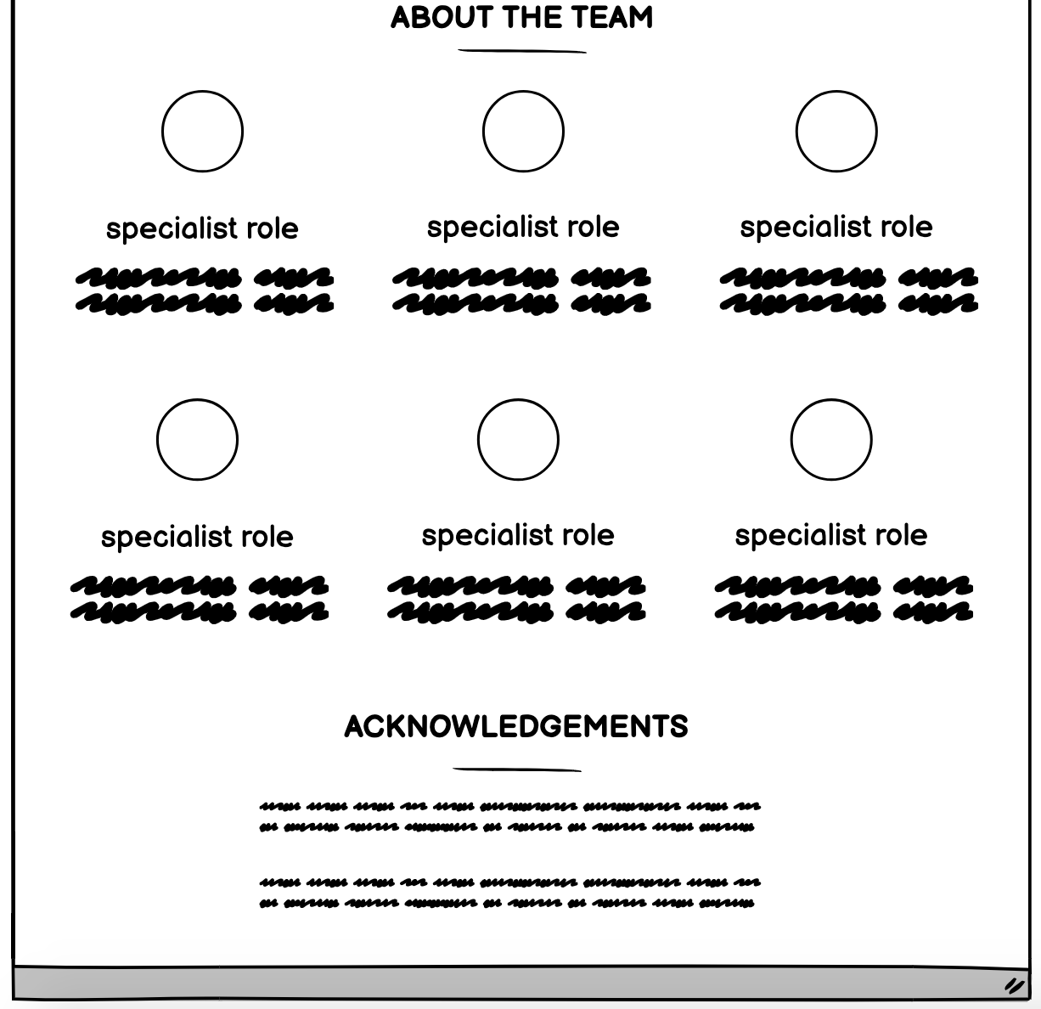
ABOUT PAGE (continued)

Slide 7
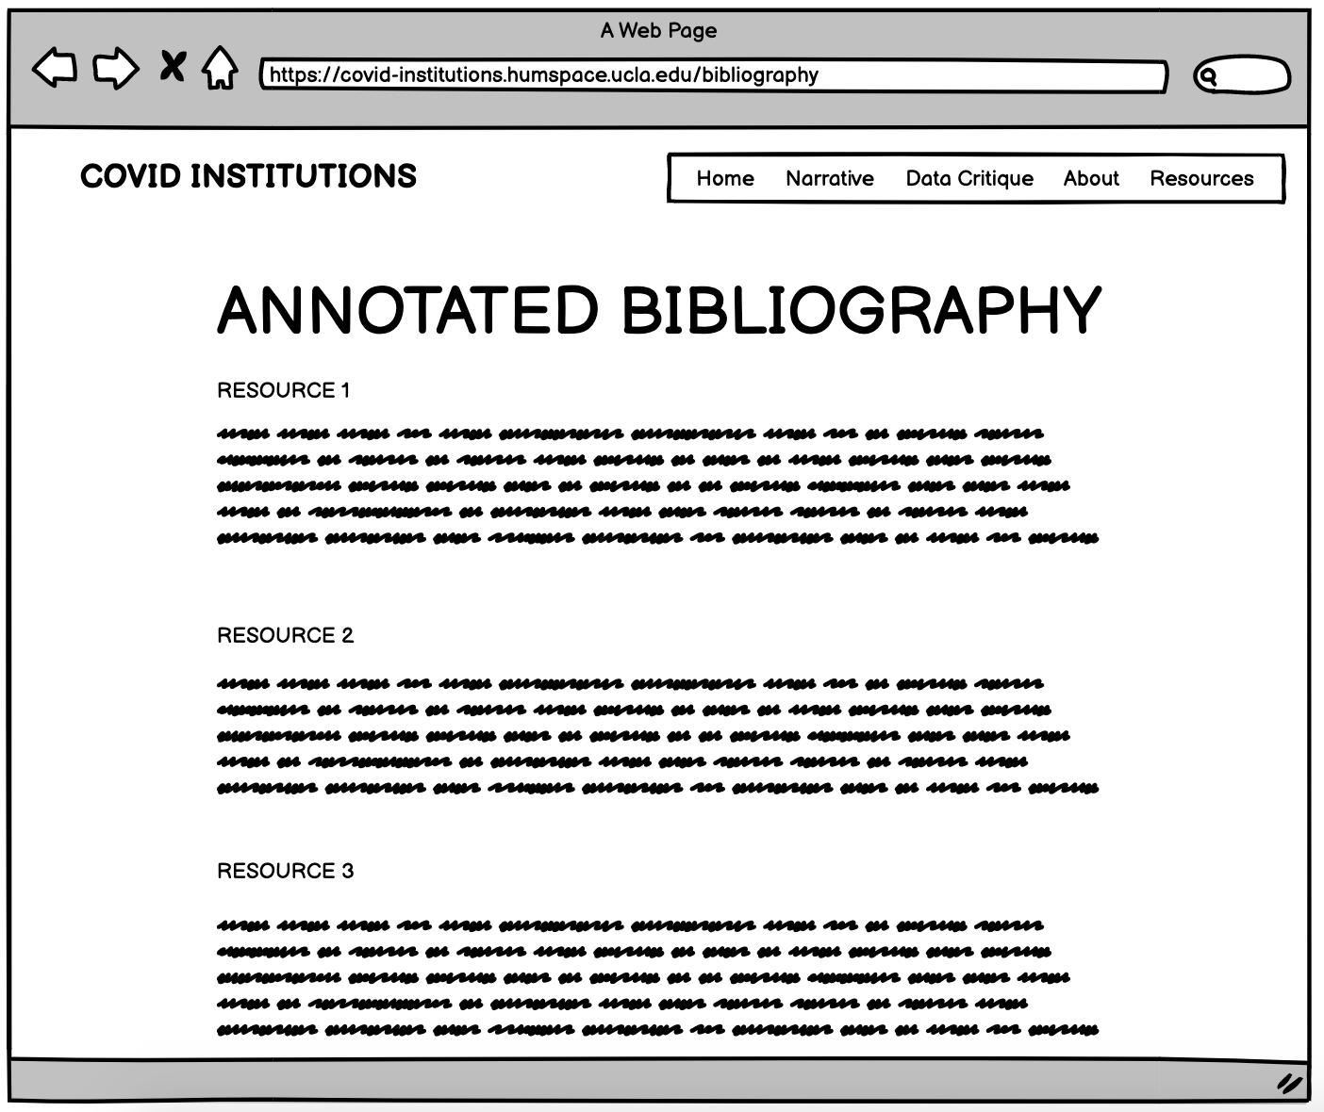
resources
page

